Slide 1
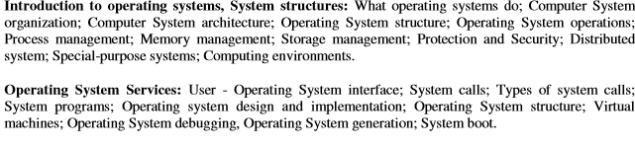
Operating system module 1

Slide 2
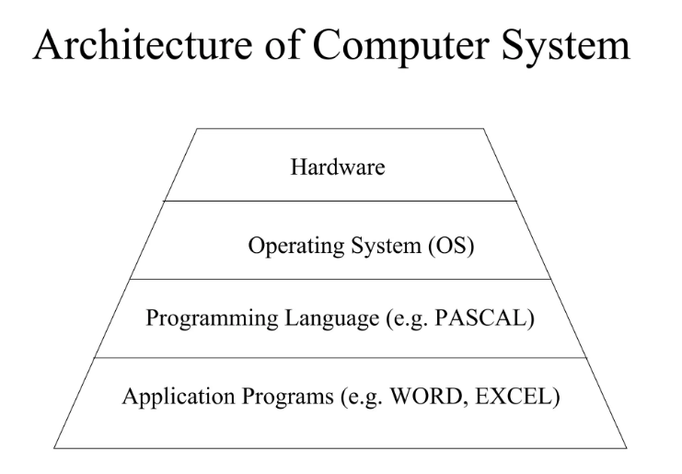
Where is your operating system ln computer ?

Slide 3
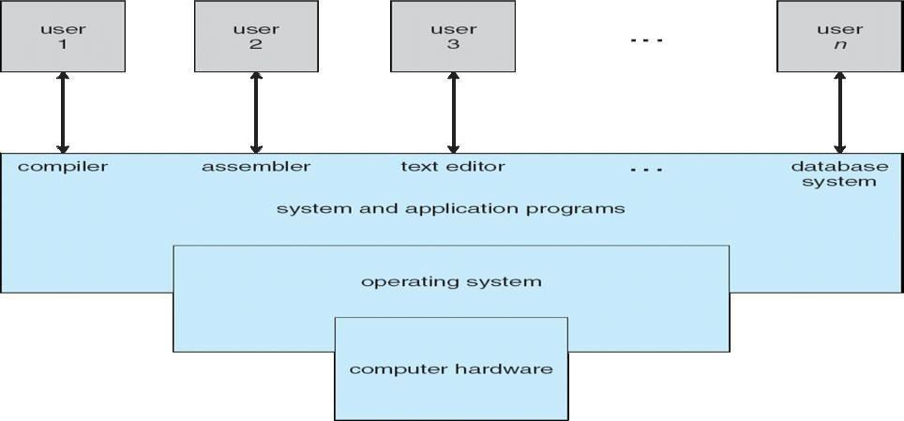
What is an Operating System?
An operating system is system software that acts as an intermediary between a user of a computer and the computer hardware.

Slide 4
Operating System can be viewed from two viewpoints–User views & System views
User Views:-
If the user is using standalone system
If the users are at different terminals connected to a mainframe or minicomputers.
If the users are in workstations.
Users of hand held systems
System Views:-
Operating system can be viewed as a resource allocator and control program.
Resource allocator
Control Program

Slide 5
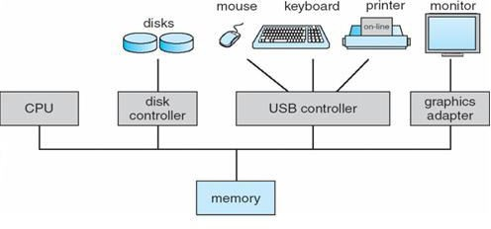
Computer System Organization
Computer-system operation
When system is switched on, ‘Bootstrap’ program is executed
‘Bootstrap’ program
  Initializes the registers, memory and I/O devices
  Locates & loads kernel into memory
  Starts with ‘init’ process
  Waits for interrupt from user

Slide 6
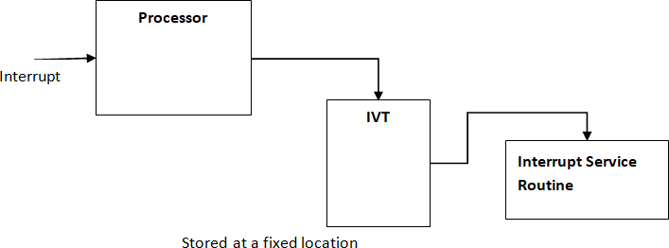
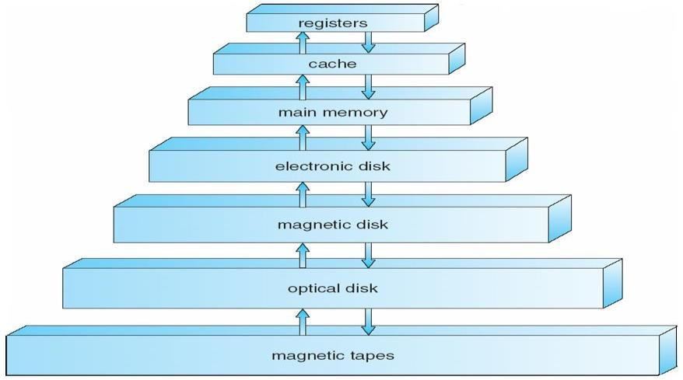
Computer System Organization
Interrupt handling storage structure
Cashing
Information in use copied from slower to faster storage temporarily. Faster storage (cache) checked first to determine if information is there, If it is, information used directly from the cache (fast) .If not, data copied to cache and used their Cache smaller than storage being cached Cache management

Slide 7
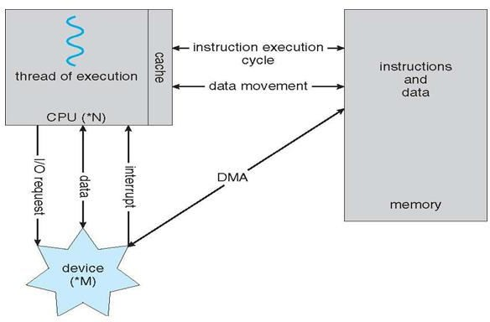
Computer System Architecture
Single-Processor Systems On a single-processor system, there is one main CPU capable of executing instructions from user processes. It contains special-purpose processors, in the form of device-specific processors, for devices such as disk, keyboard, and graphics controllers.
Multiprocessor Systems (parallel systems or tightly coupled systems)
Systems that have two or more processors in close communication, sharing the computer bus, the clock, memory, and peripheral devices are the multiprocessor systems.
Advantage : Increased throughput , Economy of scale , Increased reliability.

Slide 8
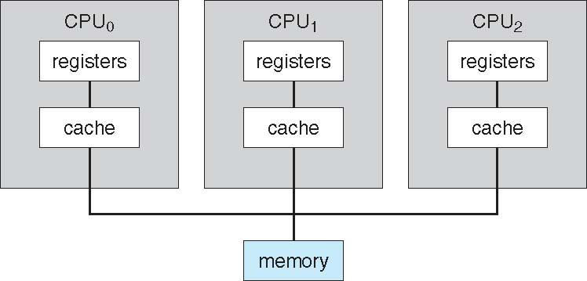
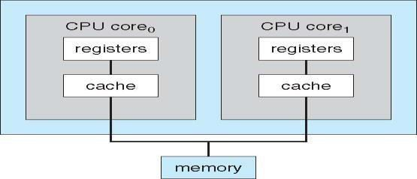
Computer System Architecture
Different types of multiprocessor systems
Asymmetric multiprocessing – (Master/Slave architecture)
Symmetric multiprocessing (SMP)
Asymmetric multiprocessing dual core system:

Slide 9
Computer System Architecture
Clustered Systems : Clustered systems are two or more individual systems connected together via network and sharing software resources. Clustering provides high-availability
There are two types of Clustered systems –
asymmetric :one system is in hot-stand by mode while the others are running the applications.
Symmetric : two or more systems are running applications, and are monitoring each other.
Other forms of clusters include parallel clusters and clustering over a wide-area network (WAN)

Slide 10
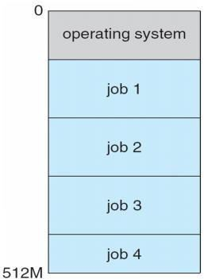
Computer System Structure
Multiprogramming needed for efficiency
  Single user cannot keep CPU and I/O devices busy at all times
  Multiprogramming organizes jobs (code and data) so CPU always
  has one to execute
  A subset of total jobs in system is kept in memory
  One job selected and run via job scheduling
  When it has to wait (for I/O for example), OS switches to another job
Timesharing (multitasking) is logical extension in which CPU switches
jobs so frequently that users can interact with each job while it is running,
creating interactive computing
  Response time should be < 1 second
  Each user has at least one program executing in memory process
  If several jobs ready to run at the same time  CPU scheduling
  If processes don’t fit in memory, swapping moves them in and out to run
  Virtual memory allows execution of processes not completely in memory

Slide 11
Computer System Structure
Distributed Systems
Individual systems that are connected and share the resource available in network is called Distributed system .A network is a communication path between two or more systems.
Networks are characterized based on the distances between their nodes.
A local-area network (LAN) connects computers within a room, a floor, or a building.
A wide-area network (WAN) usually links buildings, cities, or countries. A global company may have a WAN to connect its offices worldwide.
A metropolitan-area network (MAN) links buildings within a city.
A small-area network connects systems within a several feet using wireless technology.

Slide 12
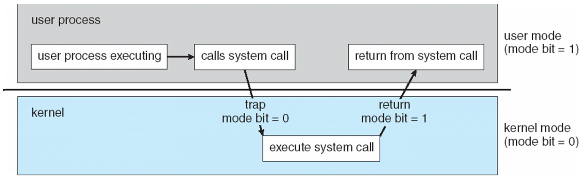
Computer System operations
Dual-mode operation allows OS to protect itself and other system components
  User mode and kernel mode
  Mode bit provided by hardware
    Provides ability to distinguish when system is running user code or kernel code
    Some instructions designated as privileged, only executable in kernel mode
    System call changes mode to kernel, return from call resets it to user
Timer to prevent infinite loop / process hogging resources
  Set interrupt after specific period
  Operating system decrements counter
  When counter zero generate an interrupt
  Set up before scheduling process to regain
  control or terminate program that exceeds
  allotted time

Slide 13
Process Management
A process is a program in execution. It is a unit of work within the system. Program is a passive entity, process is an active entity.
Process needs resources to accomplish its task
  CPU, memory, I/O, files
  Initialization data
Process termination requires reclaim of any reusable resources
Single-threaded process has one program counter specifying location of next instruction to execute
  Process executes instructions sequentially, one at a time, until completion
Multi-threaded process has one program counter per thread
Typically system has many processes, some user, some operating system running concurrently on one or more CPUs
  Concurrency by multiplexing the CPUs among the processes / threads

Slide 14
Process Management
Activities
The operating system is responsible for the following activities in connection with process management:
Creating and deleting both user and system processes
Suspending and resuming processes
Providing mechanisms for process synchronization
Providing mechanisms for process communication
Providing mechanisms for deadlock handling

Slide 15
Memory Management
All data in memory before and after processing
All instructions in memory in order to execute
Memory management determines what is in memory when
  Optimizing CPU utilization and computer response to users
Memory management activities
  Keeping track of which parts of memory are currently being used and by whom
  Deciding which processes (or parts thereof) and data to move into and out of memory
  Allocating and de-allocating memory space as needed

Slide 16
Storage Management
OS provides uniform, logical view of information storage
  Abstracts physical properties to logical storage unit - file
  Each medium is controlled by device (i.e., disk drive, tape drive)
    Varying properties include access speed, capacity, data-transfer rate, access method (sequential or random)
File-System management
  Files usually organized into directories
  Access control on most systems to determine who can access what
  OS activities include
    Creating and deleting files and directories
    Primitives to manipulate files and dirs
    Mapping files onto secondary storage
    Backup files onto stable (non-volatile) storage media

Slide 17
Storage Management
File-System Management
The operating system is responsible for the following activities in connection with file management:
    Creating and deleting files
    Creating and deleting directories to organize files
    Supporting primitives for manipulating files and directories
    Mapping files onto secondary storage
    Backing up files on stable (nonvolatile) storage media

Slide 18
Storage Management
Mass-Storage Management
Usually disks used to store data that does not fit in main memory or data that must be kept for a “long” period of time
Proper management is of central importance
Entire speed of computer operation hinges on disk subsystem and its algorithms
OS activities
  Free-space management
  Storage allocation
  Disk scheduling
Some storage need not be fast
  Tertiary storage includes optical storage, magnetic tape
  Still must be managed
  Varies between WORM (write-once, read-many-times) and RW (read-write

Slide 19
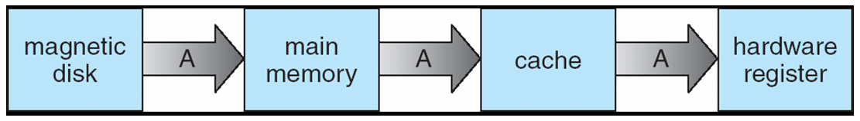
Storage Management
Caching
Caching is an important principle of computer systems. Information is normally kept in some storage system (such as main memory). As it is used, it is copied into a faster storage system— the cache—as temporary data
Multitasking environments must be careful to use most recent value, no matter where it is stored in the storage hierarchy.
Multiprocessor environment must provide cache coherency in hardware such that all CPUs have the most recent value in their cache
Distributed environment situation even more complex
  Several copies of a datum can exist
  Various solutions covered in Chapter 17

Slide 20
Storage Management
I/O Subsystem
One purpose of OS is to hide peculiarities of hardware devices from the user
I/O subsystem responsible for
  Memory management of I/O including buffering (storing data temporarily while it is being transferred), caching (storing parts of data in faster storage for performance), spooling (the overlapping of output of one job with input of other jobs)
  General device-driver interface
  Drivers for specific hardware devices

Slide 21
Chapter 2 :Operating system services
One set of operating-system services provides functions that are helpful to the user:
  User interface - Almost all operating systems have a user interface (UI)
    Varies between Command-Line (CLI), Graphics User Interface (GUI), Batch
  Program execution - The system must be able to load a program into memory and to run that program, end execution, either normally or abnormally (indicating error)
  I/O operations - A running program may require I/O, which may involve a file or an I/O device
  File-system manipulation - The file system is of particular interest. Obviously, programs need to read and write files and directories, create and delete them, search them, list file Information, permission management.
  Communications – Processes may exchange information, on the same computer or between computers over a network
    Communications may be via shared memory or through message passing (packets moved by the OS)

Slide 22
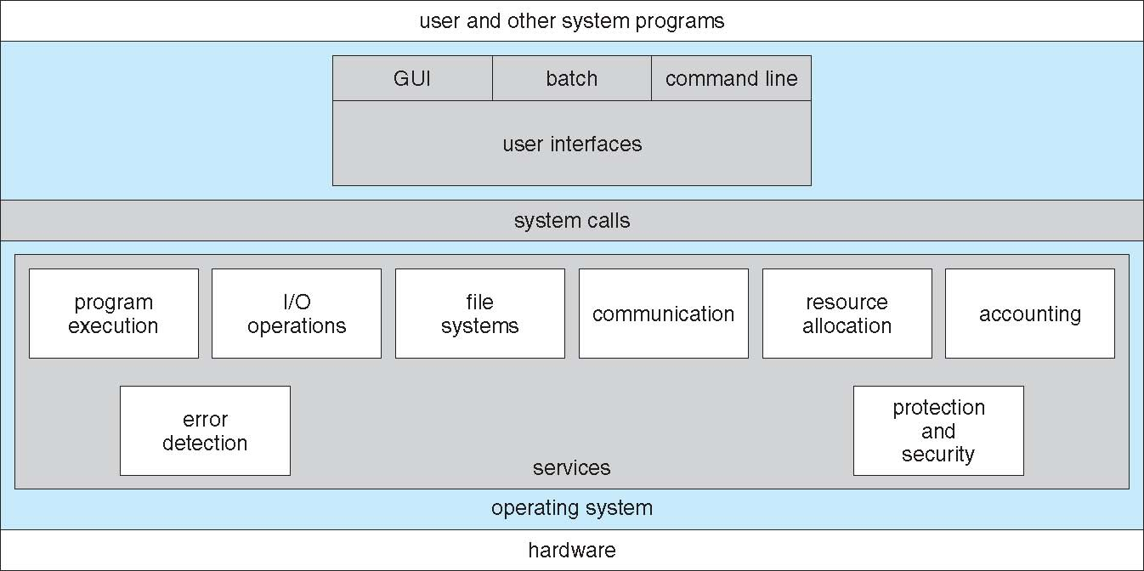
Operating system services
A View of Operating System Services
  Error detection – OS needs to be constantly aware of possible errors
    May occur in the CPU and memory hardware, in I/O devices, in user program
    For each type of error, OS should take the appropriate action to ensure correct and consistent computing
    Debugging facilities can greatly enhance the user’s and programmer’s abilities to efficiently use the system

Slide 23
Operating system services
Another set of OS functions exists for ensuring the efficient operation of the system itself via resource sharing
  Resource allocation - When multiple users or multiple jobs running concurrently, resources must be allocated to each of them
    Many types of resources - Some (such as CPU cycles, main memory, and file storage) may have special allocation code, others (such as I/O devices) may have general request and release code
  Accounting - To keep track of which users use how much and what kinds of computer resources
  Protection and security - The owners of information stored in a multiuser or networked computer system may want to control use of that information, concurrent processes should not interfere with each other
    Protection involves ensuring that all access to system resources is controlled
    Security of the system from outsiders requires user authentication, extends to defending external I/O devices from invalid access attempts
    If a system is to be protected and secure, precautions must be instituted throughout it. A chain is only as strong as its weakest link.

Slide 24
User Operating System Interface - CLI
Command Line Interface (CLI) or command interpreter allows direct command entry
    Sometimes implemented in kernel, sometimes by systems program
    Sometimes multiple flavors implemented – shells
    Primarily fetches a command from user and executes it
      Sometimes commands built-in, sometimes just names of programs
        If the latter, adding new features doesn’t require shell modification
User-friendly desktop metaphor interface
  Usually mouse, keyboard, and monitor
  Icons represent files, programs, actions, etc
  Various mouse buttons over objects in the interface cause various actions (provide information, options, execute function, open directory (known as a folder)
  Invented at Xerox PARC
Many systems now include both CLI and GUI interfaces
  Microsoft Windows is GUI with CLI “command” shell
  Apple Mac OS X as “Aqua” GUI interface with UNIX kernel underneath and shells available
  Solaris is CLI with optional GUI interfaces (Java Desktop, KDE)

Slide 25
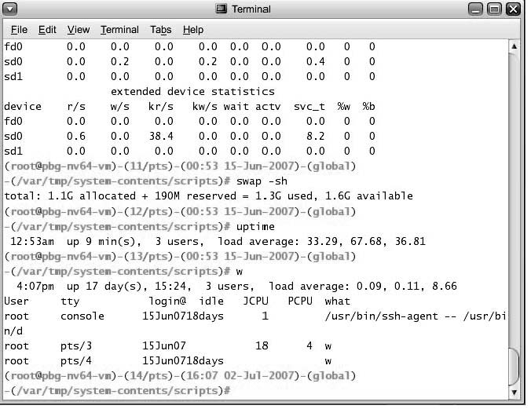
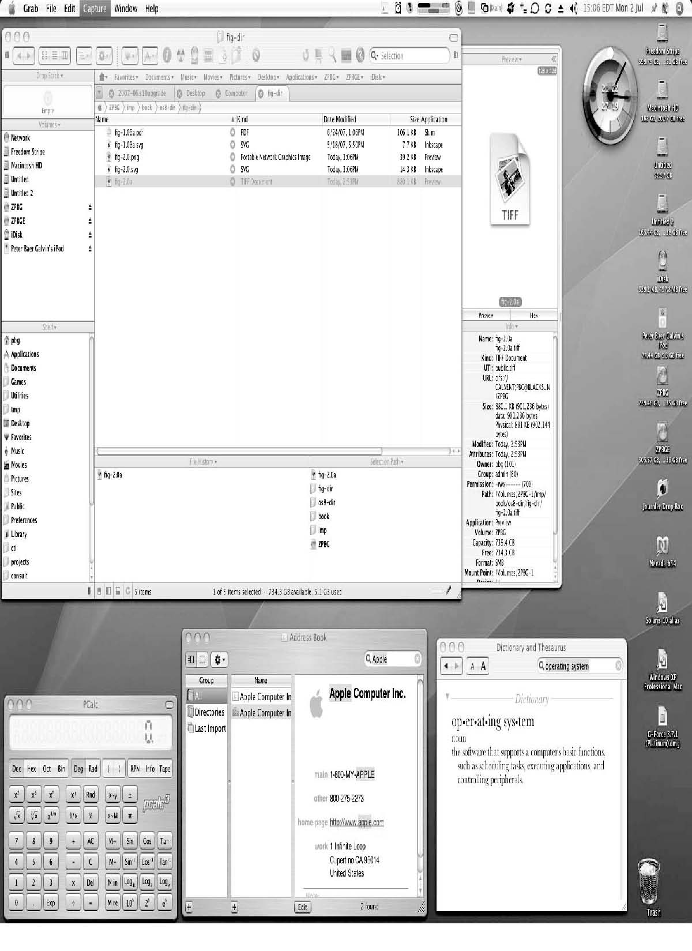
Bourne Shell Command Interpreter
The Mac OS X GUI

Slide 26
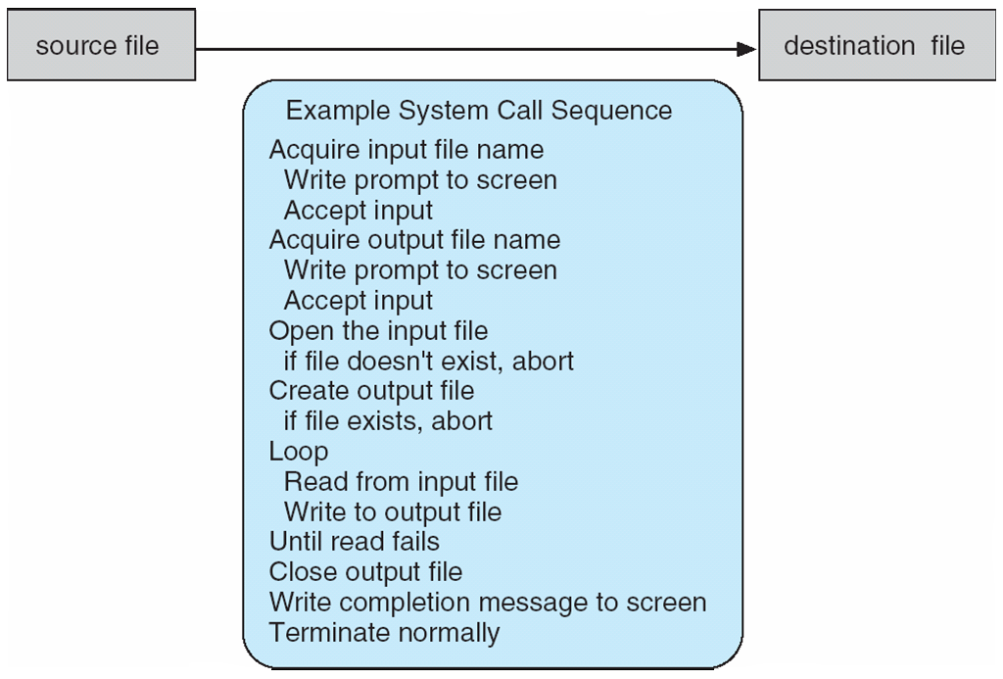
System Calls
System call sequence to copy the contents of one file to another file
Programming interface to the services provided by the OS
Typically written in a high-level language (C or C++)
Mostly accessed by programs via a high-level Application Program Interface (API) rather than direct system call use
Three most common APIs are Win32 API for Windows, POSIX API for POSIX-based systems (including virtually all versions of UNIX, Linux, and Mac OS X), and Java API for the Java virtual machine (JVM)
Why use APIs rather than system calls?
(Note that the system-call names used throughout this text are generic)

Slide 27
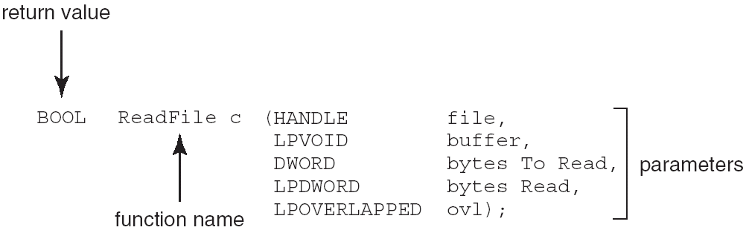
Example of Standard API
Consider the ReadFile() function in the
Win32 API—a function for reading from a file
A description of the parameters passed to ReadFile()
  HANDLE file—the file to be read
  LPVOID buffer—a buffer where the data will be read into and written from
  DWORD bytesToRead—the number of bytes to be read into the buffer
  LPDWORD bytesRead—the number of bytes read during the last read
  LPOVERLAPPED ovl—indicates if overlapped I/O is being used

Slide 28
System Call Implementation
Typically, a number associated with each system call
  System-call interface maintains a table indexed according to these numbers
The system call interface invokes intended system call in OS kernel and returns status of the system call and any return values
The caller need know nothing about how the system call is implemented
  Just needs to obey API and understand what OS will do as a result call
  Most details of OS interface hidden from programmer by API
    Managed by run-time support library (set of functions built into libraries included with compiler)

Slide 29
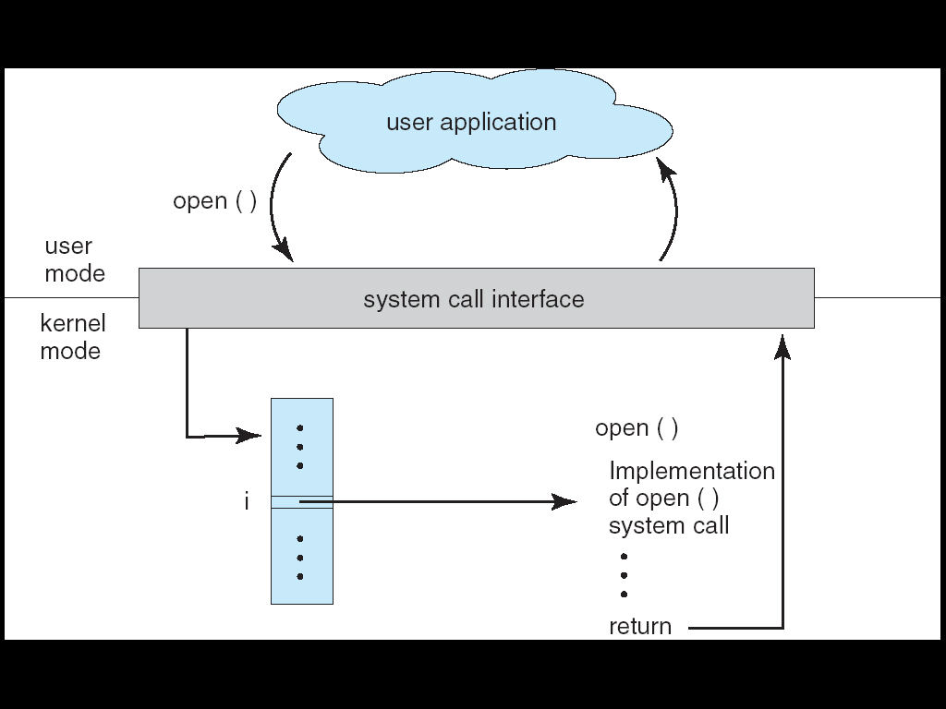
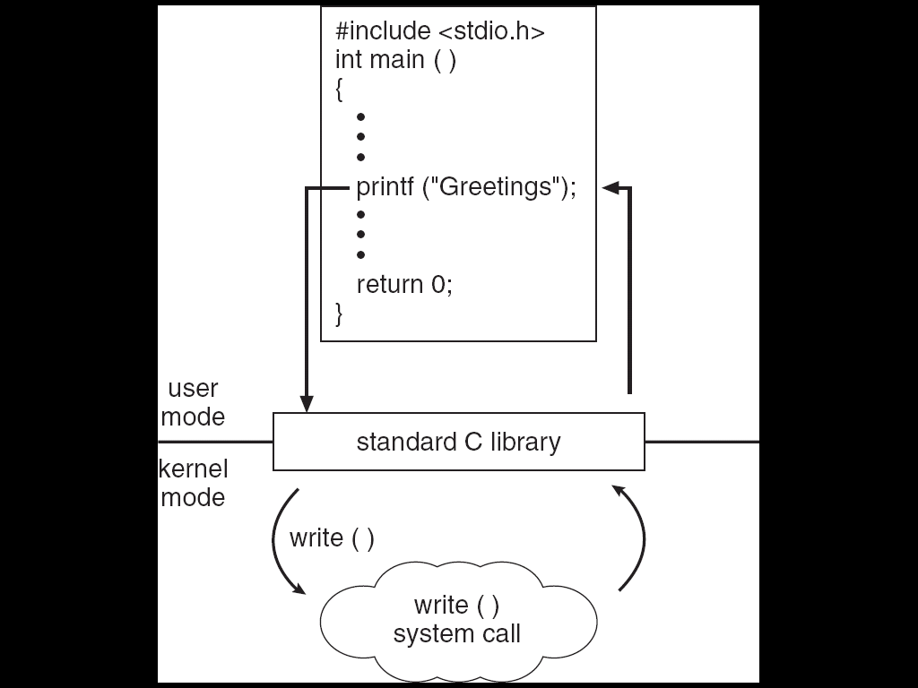
API – System Call – OS Relationship
Standard C Library Example
C program invoking printf() library call, which calls write() system call

Slide 30
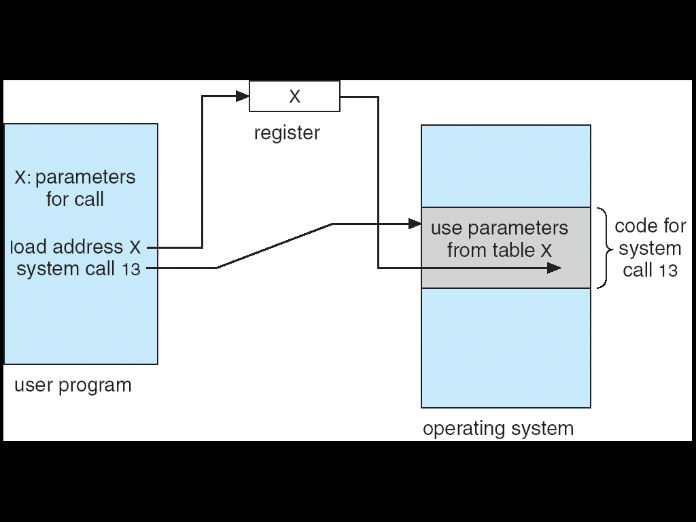
System Call Parameter Passing
Often, more information is required than simply identity of desired system call
  Exact type and amount of information vary according to OS and call
Three general methods used to pass parameters to the OS
  Simplest: pass the parameters in registers
    In some cases, may be more parameters than registers
  Parameters stored in a block, or table, in memory, and address of block passed as a parameter in a register
    This approach taken by Linux and Solaris
  Parameters placed, or pushed, onto the stack by the program and popped off the stack by the operating system
  Block and stack methods do not limit the number or length of parameters being passed
Parameter Passing via Table

Slide 31
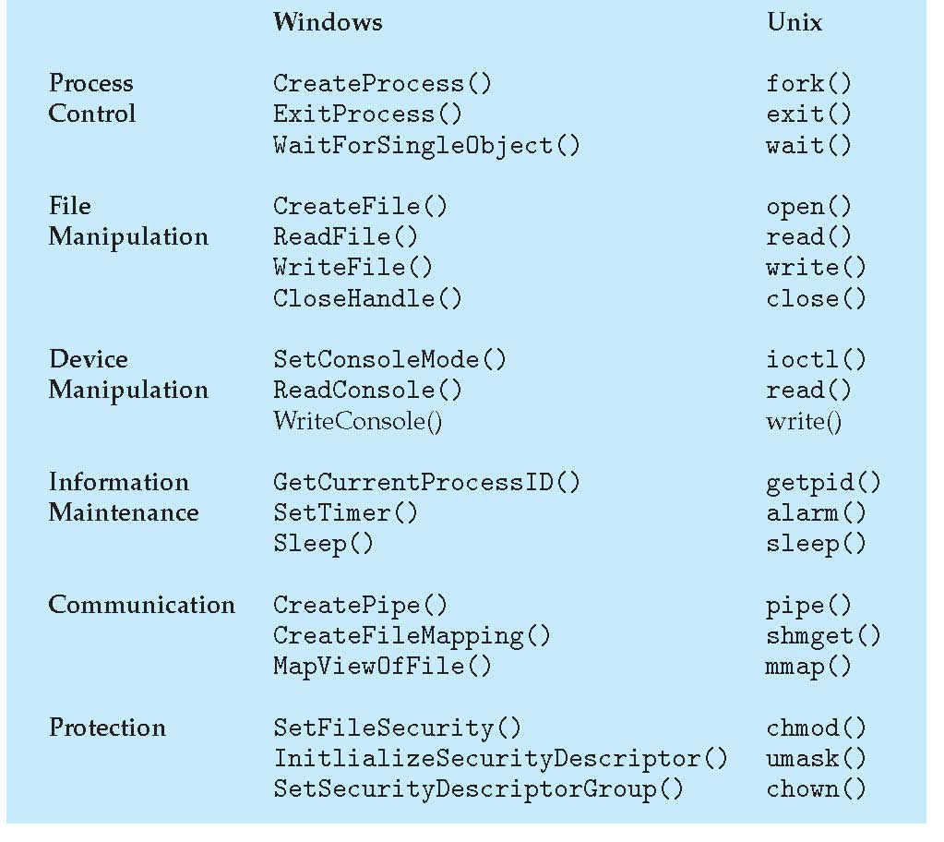
Types of System Calls
Process control
File management
Device management
Information maintenance
Communications
Protection

Slide 32
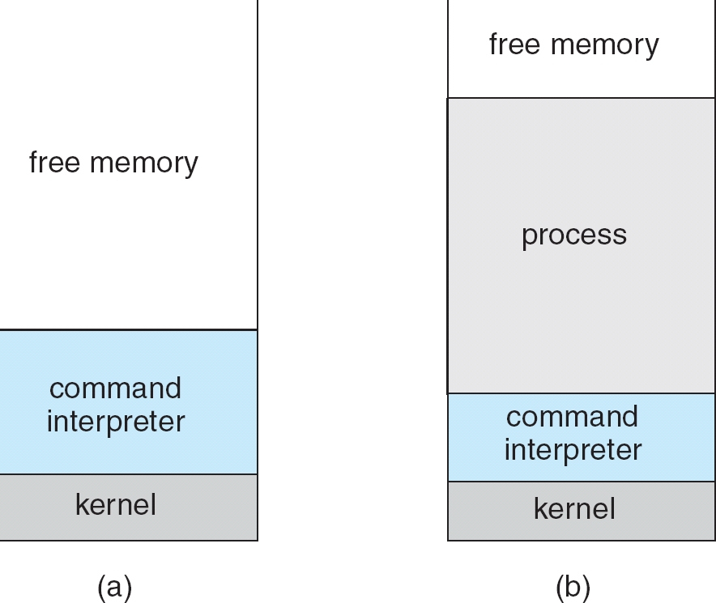
MS-DOS execution
(a) At system startup (b) running a program

Slide 33
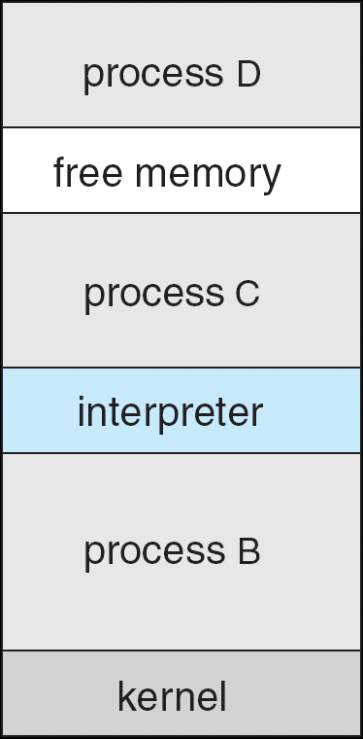
FreeBSD Running Multiple Programs

Slide 34
System Programs
System programs provide a convenient environment for program development and execution. The can be divided into:
  File manipulation
  Status information
  File modification
  Programming language support
  Program loading and execution
  Communications
  Application programs
Most users’ view of the operation system is defined by system programs, not the actual system calls

Slide 35
Operating System Design and Implementation
Design and Implementation of OS not “solvable”, but some approaches have proven successful
Internal structure of different Operating Systems can vary widely
Start by defining goals and specifications
Affected by choice of hardware, type of system
User goals and System goals
  User goals – operating system should be convenient to use, easy to learn, reliable, safe, and fast
  System goals – operating system should be easy to design, implement, and maintain, as well as flexible, reliable, error-free, and efficient
Important principle to separate
Policy: What will be done?
Mechanism: How to do it?
Mechanisms determine how to do something, policies decide what will be done
  The separation of policy from mechanism is a very important principle, it allows maximum flexibility if policy decisions are to be changed later

Slide 36
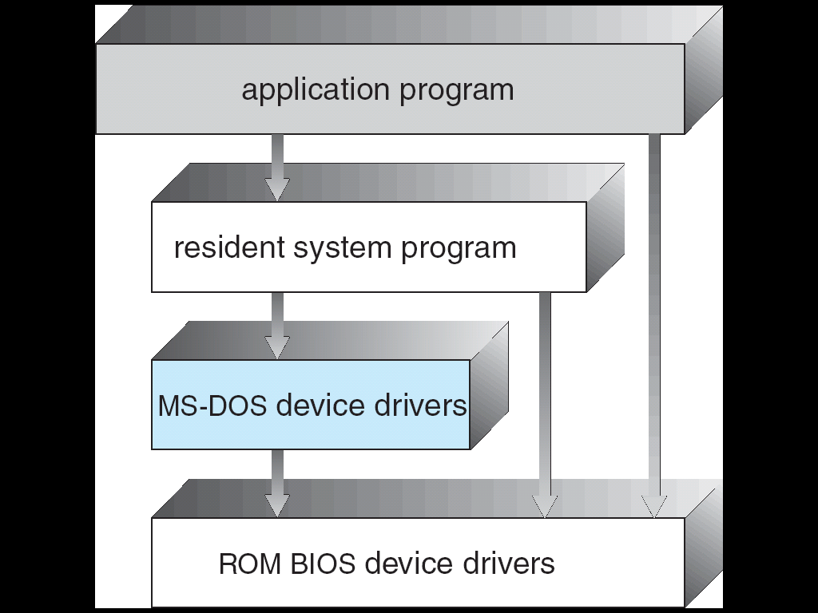
Simple Structure
MS-DOS – written to provide the most functionality in the least space
  Not divided into modules
  Although MS-DOS has some structure, its interfaces and levels of functionality are not well separated
  MS-DOS Layer Structure

Slide 37
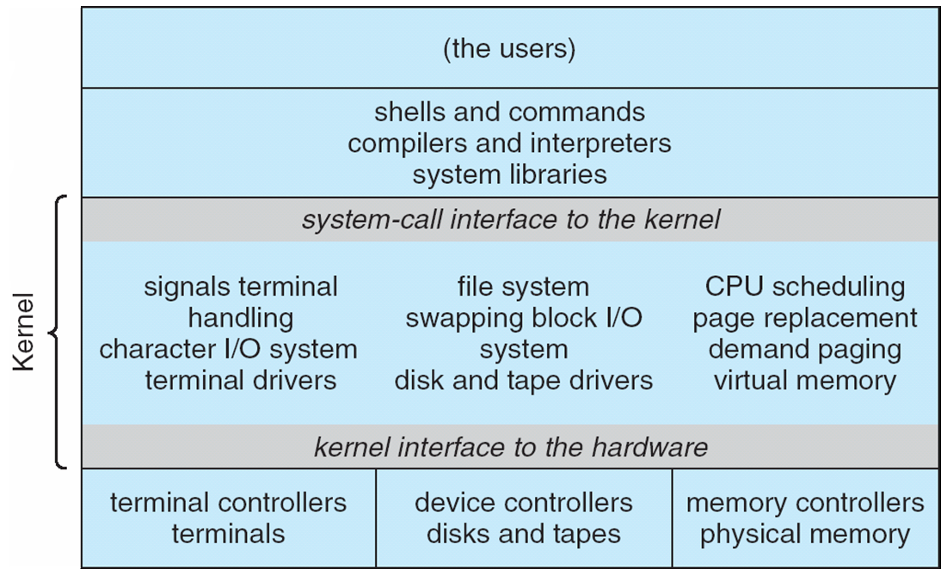
Traditional UNIX System Structure

Slide 38
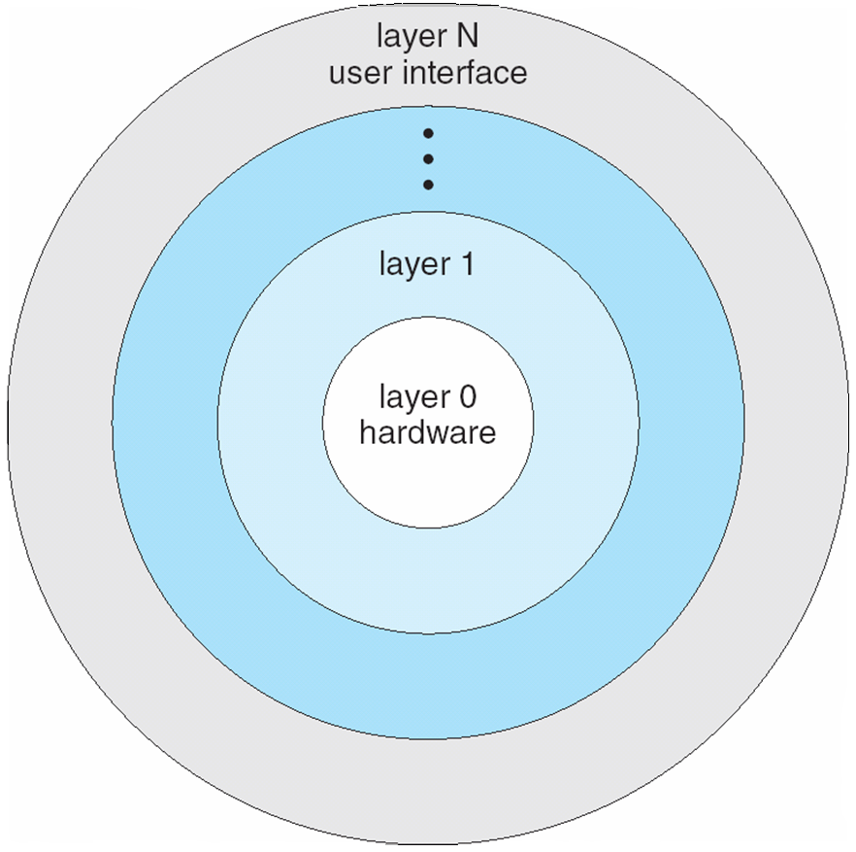
Simple Structure
Layered Approach
The operating system is divided into a number of layers (levels), each built on top of lower layers. The bottom layer (layer 0), is the hardware; the highest (layer N) is the user interface.
With modularity, layers are selected such that each uses functions (operations) and services of only lower-level layers

Slide 39
UNIX
UNIX – limited by hardware functionality, the original UNIX operating system had limited structuring. The UNIX OS consists of two separable parts
  Systems programs
  The kernel
    Consists of everything below the system-call interface and above the physical hardware
    Provides the file system, CPU scheduling, memory management, and other operating-system functions; a large number of functions for one level

Slide 40
Microkernel System Structure
Moves as much from the kernel into “user” space
Communication takes place between user modules using message passing
Benefits:
  Easier to extend a microkernel
  Easier to port the operating system to new architectures
  More reliable (less code is running in kernel mode)
  More secure
Detriments:
  Performance overhead of user space to kernel space communication

Slide 41
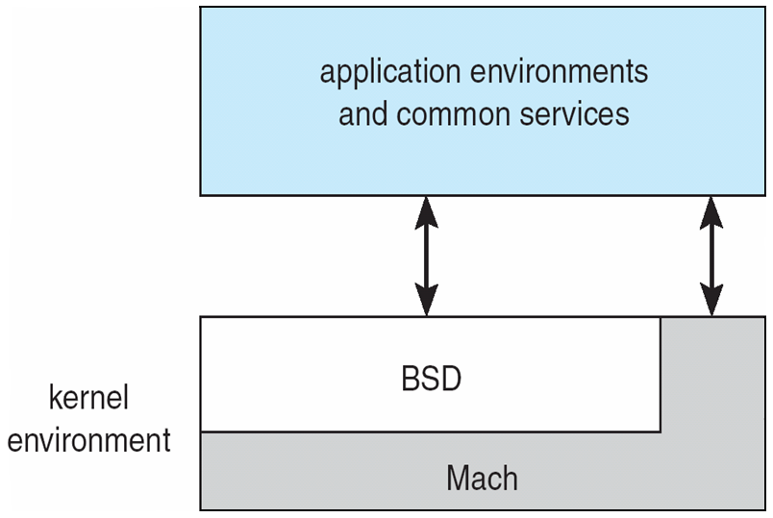
Mac OS X Structure

Slide 42
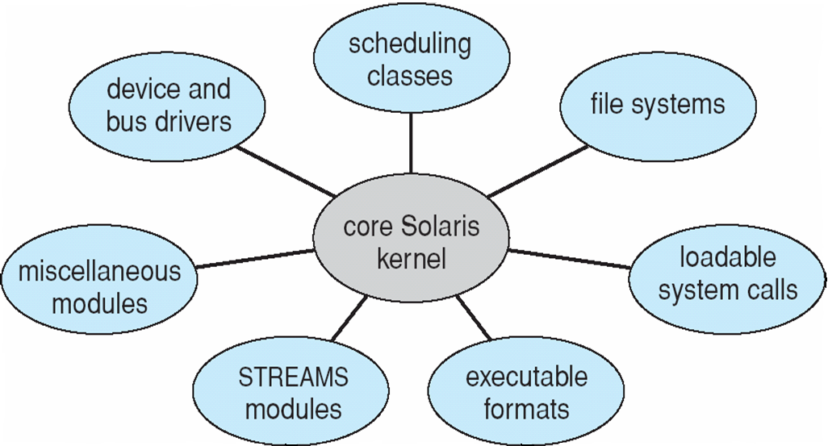
Simple Structure
Modules
Most modern operating systems implement kernel modules
  Uses object-oriented approach
  Each core component is separate
  Each talks to the others over known interfaces
  Each is loadable as needed within the kernel
Overall, similar to layers but with more flexible
Solaris Modular Approach

Slide 43
Virtual Machines
A virtual machine takes the layered approach to its logical conclusion. It treats hardware and the operating system kernel as though they were all hardware
A virtual machine provides an interface identical to the underlying bare hardware
The operating system host creates the illusion that a process has its own processor and (virtual memory)
Each guest provided with a (virtual) copy of underlying computer

Slide 44
Virtual Machines History and Benefits
First appeared commercially in IBM mainframes in 1972
Fundamentally, multiple execution environments (different operating systems) can share the same hardware
Protect from each other
Some sharing of file can be permitted, controlled
Commutate with each other, other physical systems via networking
Useful for development, testing
Consolidation of many low-resource use systems onto fewer busier systems
“Open Virtual Machine Format”, standard format of virtual machines, allows a VM to run within many different virtual machine (host) platforms

Slide 45
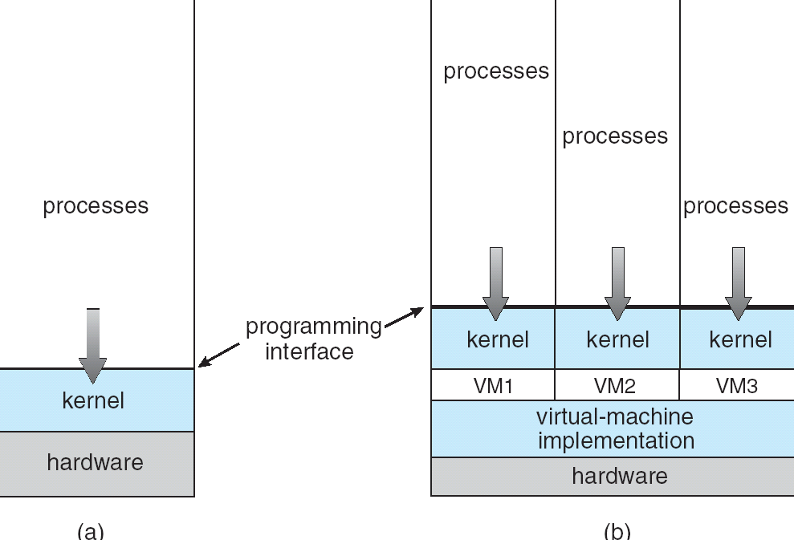
Virtual Machines (Cont)
(a) Nonvirtual machine (b) virtual machine
Non-virtual Machine
Virtual Machine

Slide 46
Para-virtualization
Presents guest with system similar but not identical to hardware
Guest must be modified to run on paravirtualized hardwareF
Guest can be an OS, or in the case of Solaris 10 applications running in containers

Slide 47
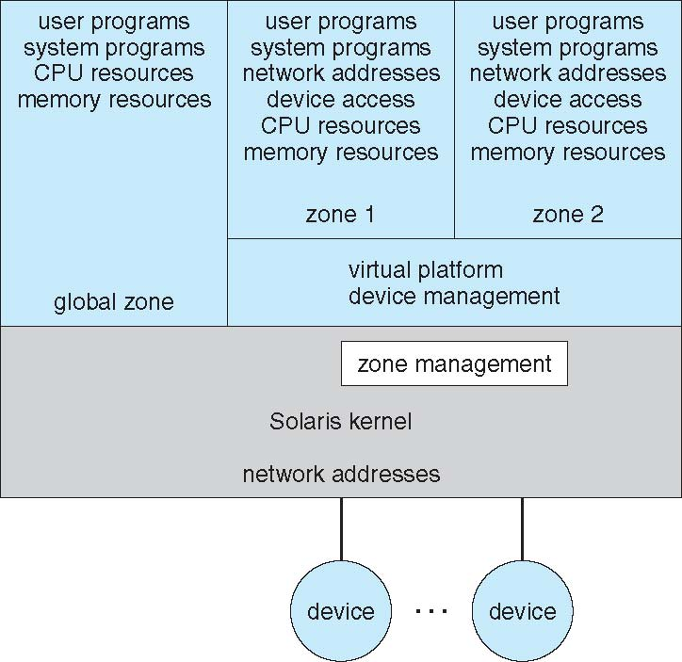
Solaris 10 with Two Containers

Slide 48
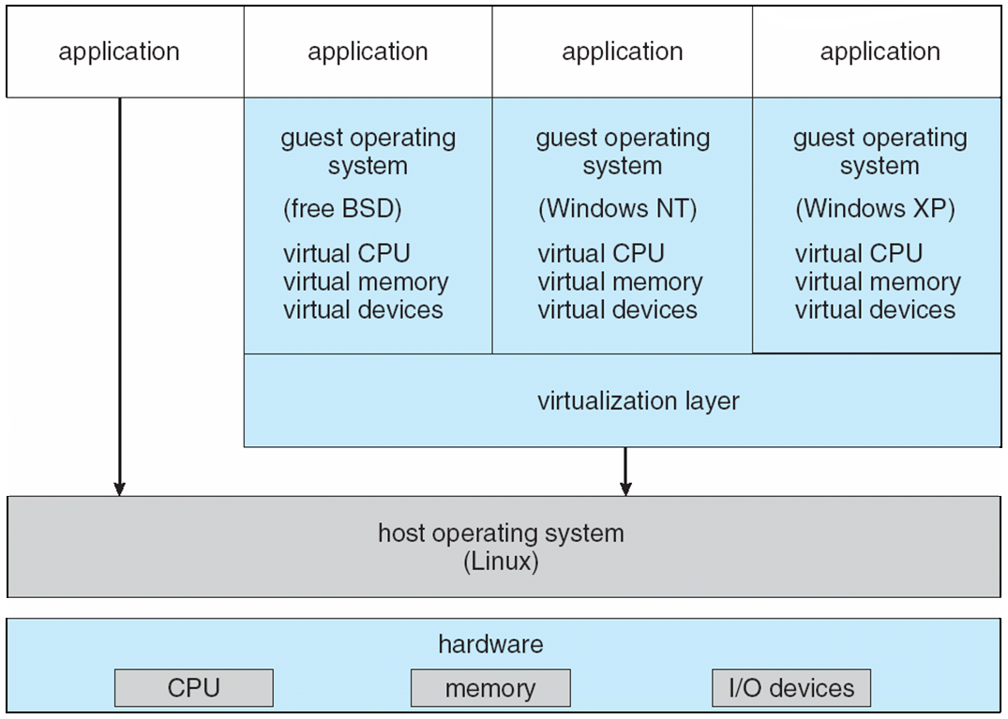
VMware Architecture

Slide 49
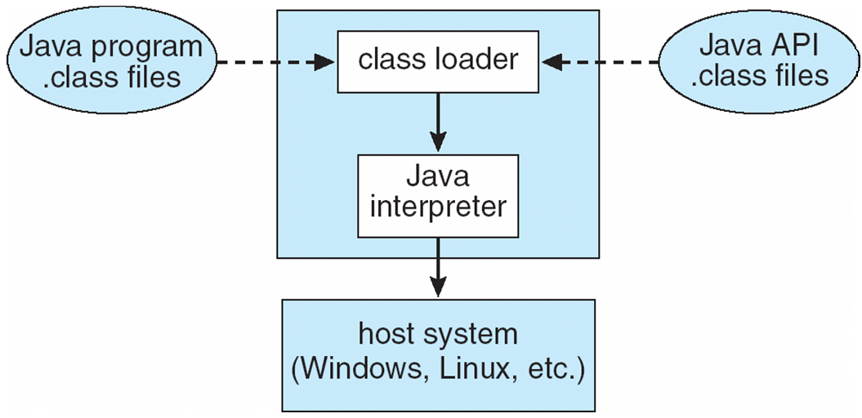
The Java Virtual Machine

Slide 50
Operating-System Debugging
Debugging is finding and fixing errors, or bugs
OSes generate log files containing error information
Failure of an application can generate core dump file capturing memory of the process
Operating system failure can generate crash dump file containing kernel memory
Beyond crashes, performance tuning can optimize system performance
Kernighan’s Law: “Debugging is twice as hard as writing the code in the ﬁrst place. Therefore, if you write the code as cleverly as possible, you are, by deﬁnition, not smart enough to debug it.”
DTrace tool in Solaris, FreeBSD, Mac OS X allows live instrumentation on production systems
  Probes fire when code is executed, capturing state data and sending it to consumers of those probes

Slide 51
Operating System Generation
Operating systems are designed to run on any of a class of machines; the system must be configured for each specific computer site
SYSGEN program obtains information concerning the specific configuration of the hardware system
Booting – starting a computer by loading the kernel
Bootstrap program – code stored in ROM that is able to locate the kernel, load it into memory, and start its execution

Slide 52
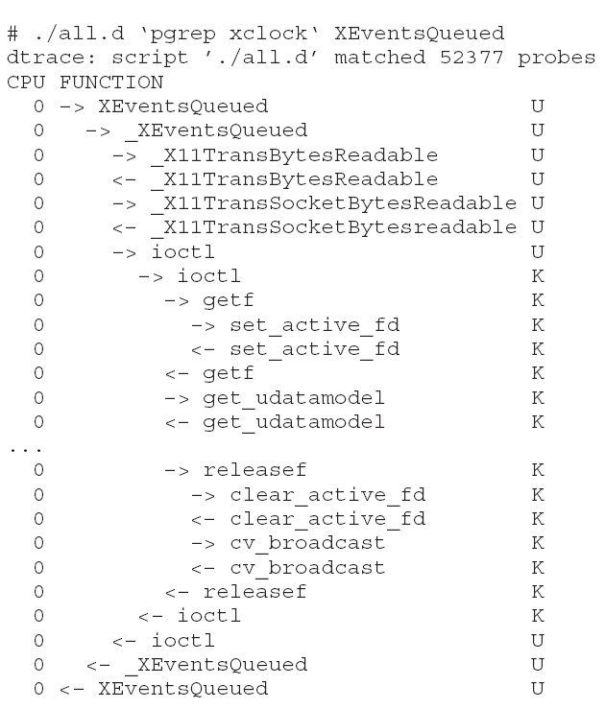
Solaris 10 dtrace Following System Call

Slide 53
System Boot
Operating system must be made available to hardware so hardware can start it
  Small piece of code – bootstrap loader, locates the kernel, loads it into memory, and starts it
  Sometimes two-step process where boot block at fixed location loads bootstrap loader
  When power initialized on system, execution starts at a fixed memory location
    Firmware used to hold initial boot code

